Slide 1
Data Binding
Week 10
Advanced Native Mobile Programming
Teknik Informatika - Universitas Surabaya

Slide 2
0.
The Concept

Slide 3
Data Binding Library
The Data Binding Library is a support library that allows you to bind UI components in your layouts to data sources in your app using a declarative format rather than programmatically.

Slide 4
Without Data Binding
Without data binding, you have to make many UI framework calls in your activities.
It usually utilize the findViewById method
For example, change textview text:
var judul = findViewById<TextView>(R.id.txtJudul)
judul.text = “the title”
Another example, if you use android KTX:
import kotlinx.android.synthetic.main.fragment_baruku.*
judul.text = “the title”

Slide 5
The Problem
Null pointer exception risk
Encapsulation Breach
findViewById() is a way to break into view layout, get knowledge about its internal structure and start manipulating it based on that knowledge
findViewById soon will be deprecated

Slide 6
Implement Data Binding
Data binding is already embedded in the project. It dont need additional dependencies
However it needs to be activated
buildFeatures {
dataBinding true
}

Slide 7
<layout> tag
Data binding layout files are slightly different and start with a root tag of layout followed by a data element and a view root element.
This tag encapsulates UI and enable the data binding
<layout>
. . . your layout UI structure here
</layout>

Slide 8
Data Binding Variable
Data tag and variable tag is used to define the variable that can be bind inside the layout
<data>
<variable name=”user” type=”com.example.User”/>
</data>

Slide 9
Binding Class
A binding class is generated for each layout file.
This class holds all the bindings from the layout properties (for example, the user variable) to the layout's views and knows how to assign values for the binding expressions.
val binding: ActivityMainBinding = DataBindingUtil.setContentView(
this, R.layout.activity_main)
binding.user = User("Test", "User")

Slide 10
Expression Language
Expressions within the layout are written in the attribute properties using the "@{}" syntax.
<TextView android:layout_width="wrap_content"
android:layout_height="wrap_content"
android:text="@{user.firstName}" />

Slide 11
Listener Binding
Listener bindings: These are lambda expressions that are evaluated when the event happens. Data binding always creates a listener, which it sets on the view. When the event is dispatched, the listener evaluates the lambda expression.
interface Presenter {
fun onSaveClick(task: Task)
}
. . .
android:onClick="@{() -> presenter.onSaveClick(task)}"

Slide 12
Two Way Binding
The @={} notation, which importantly includes the "=" sign, receives data changes to the property and listen to user updates at the same time.
<CheckBox
android:id="@+id/rememberMeCheckBox"
android:checked="@={viewmodel.rememberMe}"
/>

Slide 13
1.
Homework Discussion

Slide 14
The PLAN
The following tutorial will demonstrate how to implement a data binding mechanism into the adapter of the todo list and the edit fragment.

Slide 15
2.
Setup Data Binding

Slide 16
Important
The databinding library is bundled with the Android Gradle plugin. To use it, you must enable it.
To enable data binding, open the Module build gradle and add following configuration within “android”
buildFeatures {
dataBinding true
}

Slide 17
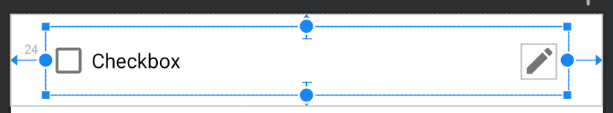
Data Binding In Item Layout
First step is to implement several data binding in item layout
Checked Checkbox
Listener binding for this checkbox
Checkbox Text
Bind the todo title into checkbox text
Edit Button
Listener Binding for this edit button

Slide 18
Encapsulate Layout with <layout>
To apply binding for particular layout, you need to encapsulate the whole layout with <layout> tags
Open the todo_item_layout. Encapsulate it with <layout>

Slide 19
Encapsulate Layout with <layout>
<layout xmlns:android="http://schemas.android.com/apk/res/android"
xmlns:app="http://schemas.android.com/apk/res-auto"
xmlns:tools="http://schemas.android.com/tools">
<androidx.constraintlayout.widget.ConstraintLayout
android:layout_width="match_parent"
android:layout_height="wrap_content">
. . .
</androidx.constraintlayout.widget.ConstraintLayout>
</layout>
IMPORTANT
Everytime you make changes on the layout (related with binding), you need to rebuild the project

Slide 20
3.
Attributes Binding

Slide 21
Define Data & Variable in Layout
Data binding allow us to inject the variable inside the layout
Add variable todo:
<layout xmlns. . .>
<data>
<variable
name="todo"
type="com.jitusolution.todoapp.model.Todo" />
</data>
TODO VARIABLE
We add todo variable in this layout mainly because it contains the Todo data (in the form of checkbox)

Slide 22
Binding the Checkbox Text Attribute
<CheckBox
android:id="@+id/checkTask"
. . .
android:text="@{todo.title}"
. . .
</CheckBox>
Expression Language
Expressions within the layout are written in the attribute properties using the "@{}" syntax
Checkbox Text
Bind the todo title into checkbox text

Slide 23
Binding Class
Do the Rebuild Project (important!)
Android Studio will build the binding class with name taken from the layout name with additional infix “binding”
For example: Layout = todo_item_layout.xml Binding class = TodoItemLayoutBinding

Slide 24
Binding Class
This binding class is needed to access the layout's variables and views
Sometimes the binding type cannot be known in advance. In such cases, the binding can be created using the DataBindingUtil class
In our case, we use DataBindingUtil class in TodoListAdapter. Why ? because binding type is hidden under the inner class ViewHolder

Slide 25
Modify The Adapter
Open the TodoListAdapter.kt
Change the ViewHolder parameter to Binding Class
From this:
class TodoViewHolder(var view:View): RecyclerView.ViewHolder(view)
To this
class TodoViewHolder(var view:TodoItemLayoutBinding):
RecyclerView.ViewHolder(view.root)

Slide 26
Instantiate Binding Object
override fun onCreateViewHolder(parent: ViewGroup, viewType: Int): TodoViewHolder {
val inflater = LayoutInflater.from(parent.context)
val view = DataBindingUtil.inflate<TodoItemLayoutBinding>
(inflater, R.layout.todo_item_layout, parent, false)
return TodoViewHolder(view)
}
Inflater
Replace the original inflate layout with DataBindingUtil inflation method. Therefore the view object now can access any variable defined in layout

Slide 27
Instantiate Todo Variable
The layout contains todo variable (object)
Instantiate this object to make data binding works properly
Comment everything inside the onBindViewHolder
override fun onBindViewHolder(holder: TodoViewHolder, position: Int) {
holder.view.todo = todoList[position]
}
Instantiate Todo
Access particular todo object based on position and set it into the variable todo in view

Slide 28
Binding Works
<variable name="todo" type="com.jitusolution.todoapp.model.Todo" />
<CheckBox
android:id="@+id/checkTask"
. . .
android:text="@{todo.title}"
. . .
</CheckBox>
Todo Variable
Since the todo object now bindable, the title property should displayed automatically, without needs the use of findViewById methods

Slide 29
4.
Listener Binding
Checked Checkbox
Listener binding for this checkbox

Slide 30
Check Task Binding
Next, implement listener binding for Check Task action
Listener bindings are binding expressions that run when an event happens
Originally a CheckedChanged listener was applied in the adapter. It requires access to the Todo object.
To change this into listener binding, first we need to a custom listener in form of interfaces

Slide 31
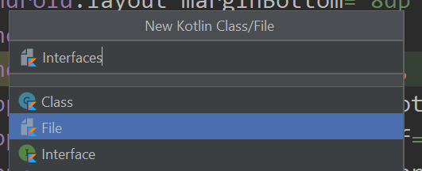
Create Interfaces Files
Right click on the View package, choose new > Kotlin file/class
Choose “File”
Name it as “Interfaces”
Why Not Interface Type?
Because we will create more than one interface and stored in single file

Slide 32
Create CheckedChage Listener Interface
interface TodoCheckedChangeListener {
fun onCheckChanged(cb: CompoundButton,
isChecked:Boolean,
obj: Todo)
}
Checked Change Listener
We define a function of CheckChanged and it requires three parameter: the checkbox, the boolean that return checkbox status, the Todo object

Slide 33
Define The Listener in Layout
Go back to todo_item_layout.xml
Create a new variable that refer to the listener
<variable
name="listener"
type="com.jitusolution.todoapp.view.TodoCheckedChangeListener" />

Slide 34
Bind The Listener Method
And then bind the listener method on the Checkbox onCheckedChange attributes
<CheckBox
android:id="@+id/checkTask"
. . .
android:text="@{todo.title}"
android:onCheckedChanged=
"@{(cb, isChecked) -> listener.onCheckChanged(cb, isChecked, todo)}"
. . .
</CheckBox>
Lambda Function
Listener binding utilize the benefit of Lambda function. The left part is method parameter (you may left this empty, and app handle it automatically).
The right part is where you trigger the actual listener (from interface)

Slide 35
Implement Interface
Next step is to implement the listener interface in the adapter class
Open the TodoListAdapter, add the interface
class TodoListAdapter(. . .):
RecyclerView.Adapter<TodoListAdapter.TodoViewHolder>(),
TodoCheckedChangeListener
{
. . .
}

Slide 36
Implement All Member
override fun onCheckChanged(cb: CompoundButton,
isChecked: Boolean, obj: Todo) {
if(isChecked) {
adapterOnClick(obj)
}
}
Check Changed
The codes is same like original. It checks for the boolean, and then trigger the function
The todo pass as argument in the function

Slide 37
Instantiate The Listener (important)
Its important to instantiate the listener
Do this in the onBindViewHolder. This listener refer to the adapter object, since its already implement the interface for itself
override fun onBindViewHolder(holder: TodoViewHolder, position: Int) {
holder.view.todo = todoList[position]
holder.view.listener = this
}

Slide 38
5.
Listener Binding
Edit Button
Listener Binding for this edit button

Slide 39
Listener Binding for Edit Button
Originally there is a listener onClick applied on the Image button
We do the same thing to replace it with listener binding. First create interface:
interface TodoEditClick {
fun onTodoEditClick(v: View)
}

Slide 40
Define the Listener Variable in Layout
Next, open the todo_item_layout.xml, and define the listener variable. Don't forget to rebuild project afterward
<variable
name="editListener"
type="com.jitusolution.todoapp.view.TodoEditClick" />

Slide 41
UUID as Argument
This listener with trigger the following action:
val action = TodoListFragmentDirections.actionEditTodoFragment(uuid)
Navigation.findNavController(v).navigate(action)
And it requires the uuid. How to get the uuid?
The “tag” attribute once again comes in handy

Slide 42
Tag Attributes Binding & Listener Binding Expression Language
<ImageView
android:id="@+id/imgEdit"
android:tag="@{todo.uuid}"
android:onClick="@{editListener::onTodoEditClick}"
...
</ImageView>
Listener Binding Without Lambda
This is the example of listener binding without use lambda function. Why? Because we dont need custom parameter for our listener. We just use the same onClick listener like it was

Slide 43
Implement The Listener
Open the TodoListAdapter
Implement the TodoEditClick listener
class TodoListAdapter(. . .):
RecyclerView.Adapter<TodoListAdapter.TodoViewHolder>(),
TodoCheckedChangeListener, TodoEditClick
{
. . .
}

Slide 44
Implement All Member
override fun onTodoEditClick(v: View) {
val uuid = v.tag.toString().toInt()
val action = TodoListFragmentDirections.actionEditTodoFragment(uuid)
Navigation.findNavController(v).navigate(action)
}
UUID Tag
Access the tag of this image view that contains UUID and passed it as argument for navigation

Slide 45
The Recap
To implement attribute binding:
Use <layout> to encapsulate the layout
Define the variable in layout
Write the expression language in the attributes (rebuild project)
Instantiate Data Class Binding
Instantiate the layout variable with data

Slide 46
The Recap
To implement listener binding:
Use <layout> to encapsulate the layout
Define the variable in layout
Write the listener interface
Write the expression language in the attributes (rebuild project)
Instantiate Data Class Binding
Implement & instantiate the listener

Slide 47
6.
Bind The Edit Layout
With Two Way Binding

Slide 48
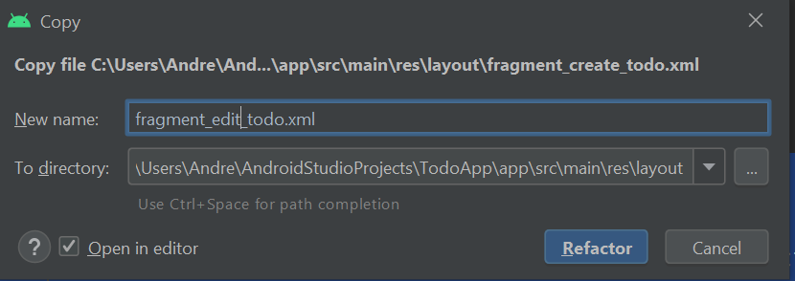
Duplicate The Create Todo Layout
For simplicity, we should use separate layout between create todo and edit todo.
Right click on fragment_create_todo.xml choose refactor > copy file
Name it as fragment_edit_todo.xml

Slide 49
<layout>
Open the fragment_edit_todo.xml, wrapped it with <layout>
<layout xmlns:android="http://schemas.android.com/apk/res/android"
xmlns:app="http://schemas.android.com/apk/res-auto"
xmlns:tools="http://schemas.android.com/tools" >
<FrameLayout . . .>
</FrameLayout>
</layout>

Slide 50
Instantiate Data Binding Class
Rebuild the project.
Open the EditTodoFragment.kt
Create the Data Binding variable
class EditTodoFragment : Fragment() {
private lateinit var viewModel: DetailTodoViewModel
private lateinit var dataBinding:FragmentEditTodoBinding

Slide 51
Instantiate Data Binding Class
Modify the onCreateView
override fun onCreateView(. . .): View? {
dataBinding = DataBindingUtil.inflate<FragmentEditTodoBinding>
(inflater, R.layout.fragment_edit_todo, container, false)
return dataBinding.root
}
Edit Todo Layout
Remember to use the newly duplicated edit layout

Slide 52
Define Todo Variable
Open the fragment_edit_todo.xml, create todo variable
<data>
<variable
name="todo"
type="com.jitusolution.todoapp.model.Todo" />
</data>

Slide 53
Instantiate Todo Variable
Open EditTodoFragment.kt
Look inside the observeviewmodel. Comment everything.
fun observeViewModel() {
viewModel.todoLD.observe(viewLifecycleOwner, Observer {
dataBinding.todo = it
}
}
Todo Databinding
This data binding object can access the todo variable that defined in the layout. After viewmodel done loading the data, the todo variable instantiate with todo live data

Slide 54
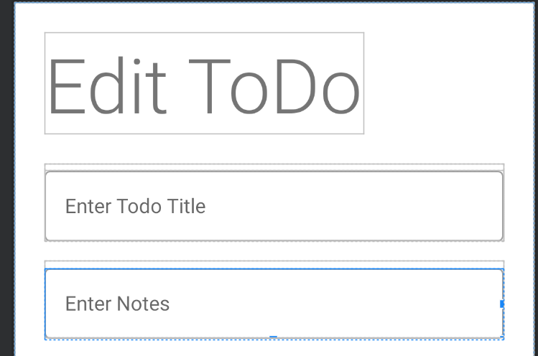
Expression Language
android:text="@={todo.title}"
android:text="@={todo.notes}"

Slide 55
Two Way Data Binding
Using one-way data binding, you can set a value on an attribute and set a listener that reacts to a change in that attribute. Two-way data binding provides a shortcut to this process.
Notice that small equals sign here: android:text="@={todo.title}"
This notation, receives data changes to the attribute and listen to variable “todo” updates at the same time.

Slide 56
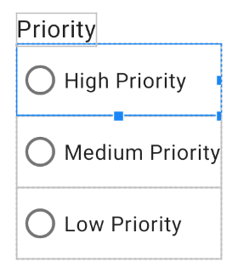
Expression Language For Radio Button
android:checked="@{todo.priority==3?true:false}"
android:checked="@{todo.priority==2?true:false}"
android:checked="@{todo.priority==1?true:false}"
Logical Expression
We can create logical expressions that evaluate value and return result based on the value.
For instances todo.priority==3?true:false means that if priority is 3 than checked attributes set to true, otherwise false

Slide 57
Radio Button Two Way Data Binding?
Two way binding on radion is too complicated to implement. Therefore we use regular listener that listen whenever the radio is selected.
Add new interface:
interface RadioClick {
fun onRadioClick(v:View, priority:Int, obj:Todo)
}

Slide 58
Define Listener Variable
Open the fragment_edit_todo.xml layout. Add new listener variable:
<variable
name="radioListener"
type="com.jitusolution.todoapp.view.RadioClick" />

Slide 59
Expression Language on Each Radio Button
Add these in each radio button separately:
Radio High
android:onClick="@{(view)->radioListener.onRadioClick(view,3, todo)}"
Radio Medium
android:onClick="@{(view)->radioListener.onRadioClick(view,2, todo)}"
Radio Low
android:onClick="@{(view)->radioListener.onRadioClick(view,1, todo)}"

Slide 60
Implement the Listener
Open the EditTodoFragment.kt, implement the listener
class EditTodoFragment : Fragment(), RadioClick {
. . .
override fun onRadioClick(v: View, priority: Int, obj: Todo) {
obj.priority = priority
}
Update Todo Priority
What we done here is to update the todo priority (high/medium/low)

Slide 61
Bind The Button Save Changes Listener
Last step is to make listener binding for button save changes.
Add the listener:
interface TodoSaveChangesClick {
fun onTodoSaveChangesClick(v: View, obj: Todo)
}
Define the variable:
<variable
name="listener"
type="com.jitusolution.todoapp.view.TodoSaveChangesClick" />

Slide 62
Expression Language & Implement Interface
The save changes button:
android:onClick=
"@{(view)->listener.onTodoSaveChangesClick(view,todo)}"
Implement Interface:
class EditTodoFragment : Fragment(), TodoSaveChangesClick, RadioClick {

Slide 63
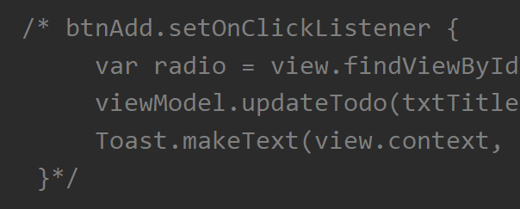
Implement Interface
override fun onTodoSaveChangesClick(v: View, obj: Todo) {
viewModel.updateTodo(obj.title, obj.notes, obj.priority, obj.uuid)
Toast.makeText(v.context, "Todo Updated", Toast.LENGTH_SHORT).show()
}
Comment The Original Listener
Dont forget to comment the btnAdd listener that originally created inside onViewCreated

Slide 64
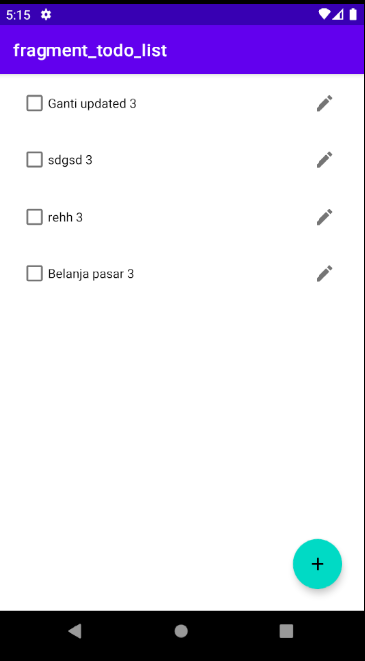
Result
Actually nothing changed visually
But your app now work more efficient

Slide 65
Thanks!
Any questions?
You can reach me at:
andre@staff.ubaya.ac.id

